Slide 1
U.S Cost of Living
Demiko Birden, Devin Fogerty, and Spencer Thompson

Slide 2
Project Proposal
We plan on using U.S cost of living data by county to analyze key factors such as housing, food, healthcare, transportation, childcare, as well as tax rates, to determine a comprehensive picture of cost of living in different counties within the state of Ohio, and if possible, throughout different regions of the U.S.

Slide 3

Question: Do metro or rural areas have a higher cost of living?

Slide 4
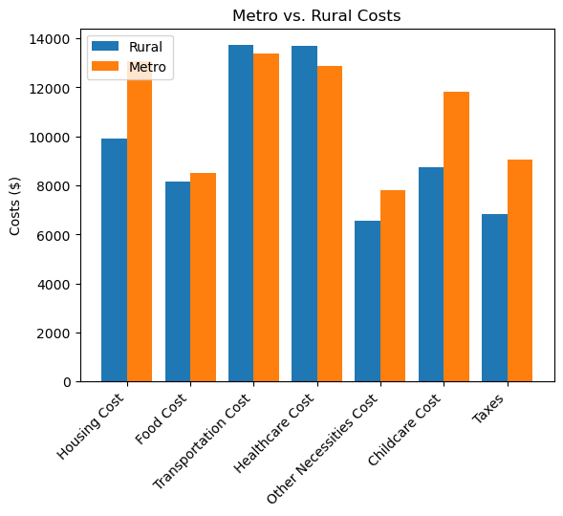
Cost of Living: Metro vs Rural
Metro areas have higher costs compared to rural areas. Metro areas spend $3,165.47 more on housing than rural areas. Both metro and rural areas have comparable food costs. With transportation cost metro areas have slightly lower costs compared to the rural areas spending $343.56 less. Rural areas spend slightly more on healthcare compared to metro areas with a difference of 156.28. With other necessity costs metro areas spend more compared to rural areas with a difference of $1,265.85. When it comes to childcare Metro areas also spend significantly more at $3,089.59. Metro areas also pay higher taxes with a difference of 2,240.45. Based on the data we gathered it appears that living in rural areas generally results in lower overall costs of living however it is important to recognize while cost of living may be lower in rural areas there are trade offs in terms of access to certain services and amenities as well as job opportunities.

Slide 5
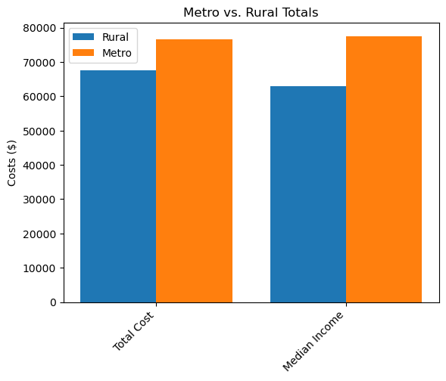
Metro vs Rural Income
Total cost - refers to all cost incurred by the household.
Median income – is the middle point of all the households income in a specific area.
In metro areas, the total cost of living is up by $9,000 compared to rural areas.
With metro areas barely clearing more than $1000 of disposable income. While rural areas have about $4,700 worth of disposable income.

Slide 6

Question: Do families with children have significantly higher cost of living, and how significant are childcare costs compared to total income?

Slide 7
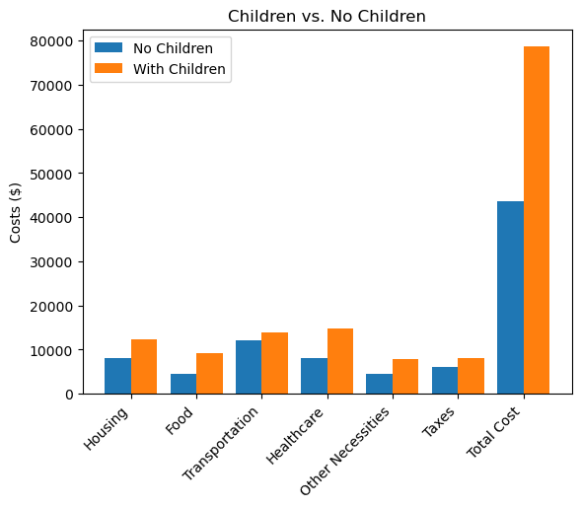
Cost of Living: Children vs No Children
Cost of living – refers to the amount of money needed to maintain a standard of living with expenses such as housing, food, transportation, etc.
Adults who are kid free live exceptionally better than adults with kids simply because they don’t have all the other expenses.
Adults with children need to find bigger homes, put more food on the table, pay more for healthcare premiums, as well as extra necessities.
Adults that live in Metro areas also pay $3,000 more than rural area parents.

Slide 8
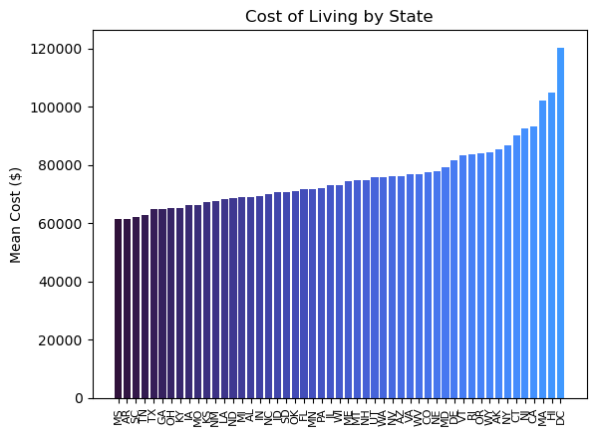
Cost of Living: State by State
Plotting the data on a bar chart makes it easy to acknowledge the differences in cost of living across the U.S
D.C has the highest cost of living with $120,289 while MS has the lowest cost of living with $61,360- a difference of $58,929.
MA,HI, and D.C appear to be sitting the furthest from the group average at $101,891, $104,897, and $120,289- while the group average is $75,823.

Slide 9
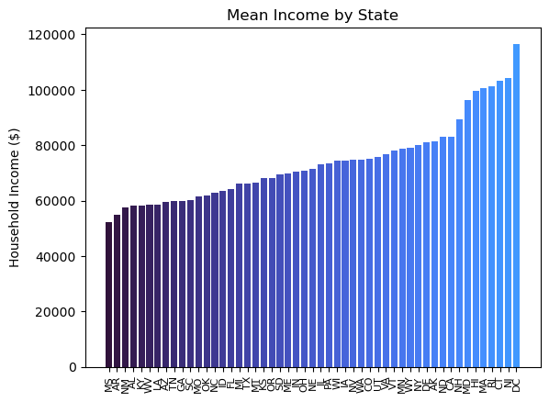
Mean Income by State
The mean income from state to state varies quite significantly from top to bottom. D.C has the highest mean income of $116,607 while Mississippi has the lowest mean income of $52,281.
While there is a significant difference between D.C and MS, the rest of the states fall much closer from Arkansas ($55,025) all the way to California ($82,922).
NH, MD, HI, MA, RI, CI, and NJ all seem to fall slightly out of what appears to be the average- with NH being at $89,200 and NJ at $104,246.
There is a strong correlation between Cost of Living and Mean Income from state to state. It is apparent as the states are generally falling in the same area for each chart.

Slide 10

Question: How significant of an effect do taxes have on cost of living, and what percentage of total income goes straight to taxes?

Slide 11
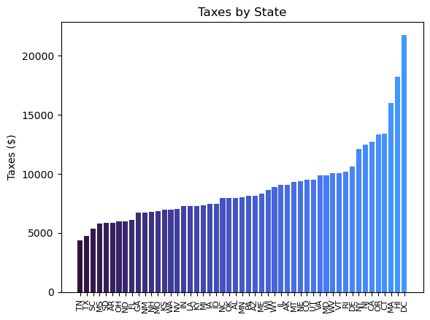
Taxes by State
There is a significant difference between the states with the highest taxes vs the states with the lowest taxes.
The state with the high taxes is D.C at $21,744 while TN is the lowest at $4,342.
HI and MA also stand significantly higher than the rest of the states at $18,172 and $15,979 respectfully.
Even though taxes are apart of cost of living, the correlation is still very little to none.

Slide 12

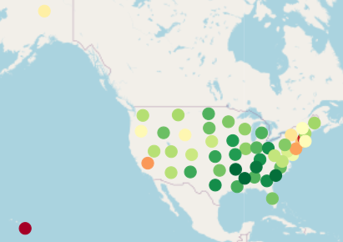
Question: What regions have the highest/lowest cost of living?

Slide 13
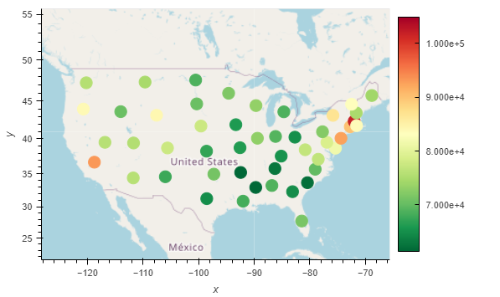
Cost of Living by State
Mapping cost of living for each state reveals that the most expensive areas of the country are regions like New England and most of the east coast, while the South and Midwest are the most affordable.
Massachusetts is the most expensive state in the continental United States at $101,900, but Hawaii is slightly more expensive, with an average annual cost of living of $104,900.
The least expensive state to live in is Mississippi, with an annual cost of $61,360.
Despite being the most populous state, California has a high $93,180 cost of living, skewed significantly by counties like Los Angeles and San Francisco.
Washington D.C. was removed from this visualization, as its mean cost of living of $120,300 was a significant outlier and skewed the color scale significantly.
Hawaii and Alaska are both out of the picture - Hawaii is the most expensive state, while Alaska is slightly above average at an annual $85,230.

Slide 14
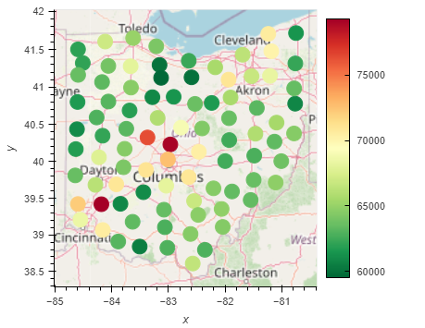
Cost of Living in Ohio, by County
Ohio has a comparatively low cost of living at $65,100 annually, lower than any of the states that share a land border with it. The cheapest county to live in is Seneca County, with an average cost of $59,520, while the most expensive county is Warren County, with an average cost of $79,310.
The large urban counties containing Cleveland, Columbus, and Cincinatti are all more expensive than the surrounding rural counties, but the most expensive places to live are in some of the suburb-filled counties that surround these major metro areas.
Mapping these costs shows a trend of higher cost of living in counties along I-71.

Slide 15
Images
https://images.app.goo.gl/GgWSdm2HagtDBbdS7
https://images.app.goo.gl/jC3w3Jho7CqAgHhi7
https://images.app.goo.gl/LUhhGcW6LeijZ52FA
https://images.app.goo.gl/oLe9fSDHEgUqBPBF6
https://images.app.goo.gl/5nreBEPUZPGeUGBZA
https://images.app.goo.gl/ncwpaEBJqp7a99cR7
https://images.app.goo.gl/6wA7AaWFej2vfciQ9
https://images.app.goo.gl/2qXahfDZc5DoUWp77
https://images.app.goo.gl/dBRrBJycNGB5wL5D9
https://images.app.goo.gl/zno5aD51S3eMjPdN7
https://images.app.goo.gl/XnMsqvKW2sarXZ6E9
https://images.app.goo.gl/JXyHvF2ScQXLcfKb6

